Slide 1
CGB1201 – FDSR PROGRAMMING PROJECT REVIEW
Department of Artificial Intelligence and Data Science
Academic Year: 2024 – 2025 (Even Semester)
Register Number : 2303811724322089
Name : REXCIA A
Year : II
Semester : IV
Section : B
Date : 02.06.2025

Slide 2
Title of the Project
CREATING A SUMMARY TABLE FOR
PRODUCT SALES

Slide 3
OBJECTIVE
Automate Sales Summary Generation :
Develop a system that automatically generates summary tables for product sales, including key metrics such as total sales, average sales, growth rates, and sales performance by product category.
Integrate Time Series Forecasting :
Include a forecasting capability to predict future sales for each product, providing businesses with both historical insights and forward-looking sales predictions to aid planning.
Streamlined Reporting :
Provide an easy-to-use, automated reporting tool that aggregates historical and forecasted sales data into a summary table, allowing businesses to make data-driven decisions efficiently.

Slide 4
PROBLEM IDENTIFICATION
Difficulty in obtaining consistent and detailed sales insights across different products and categories.
Manual report generation is time-consuming and increases the chances of errors in sales analysis.
Summarizing sales across multiple products and time periods lacks efficiency and accuracy.
Existing systems do not offer predictive analytics or future sales forecasting capabilities.
Poor inventory and marketing planning due to the absence of forward-looking sale

Slide 5
PROPOSED ARCHITECTURE
Raw sales Data
Data Preprocessing (Cleaning & Transformation)
Generate Sales Summary Table (Metrics Calculation)
Apply Forecasting Models (ARIMA)
Integrate Forecasted Sales with Historical Data (Filter/Sort)
Visualize Sales Trends & Forecasts (Graphs/Charts)
Evaluate Forecast Accuracy
Output Final Repor (Sales Summary & Forecast)

Slide 6
LIST OF MODULES
Data Collection & Preprocessing Module
Sales Summary Table Module
Forecasting & Reporting Module
Automated Reporting Module
Full System Integration Module

Slide 7
MODULE DESCRIPTION
1. Data Collection & Preprocessing Module
Collects raw sales data from multiple sources, handles missing or inconsistent values, and formats it into a clean, structured time series format suitable for analysis.
2. Sales Summary Table Module
Generates summary tables that include total sales, average sales, growth rates, and category-wise performance. Also integrates forecasted data for a complete view.

Slide 8
MODULE DESCRIPTION (Cont..)
3. Forecasting & Reporting Module
Uses ARIMA and Prophet models to predict future sales trends. Merges historical and forecasted sales into reports and visualizations for strategic planning.
4. Automated Reporting Module
Compiles all insights into a comprehensive, easy-to-read summary report. Formats include tables and visual charts for both past and projected data.

Slide 9
MODULE DESCRIPTION (Cont..)
5. Full System Integration Module
Combines all modules into a unified workflow—automating the entire process from data input to final report generation with minimal user intervention.

Slide 10
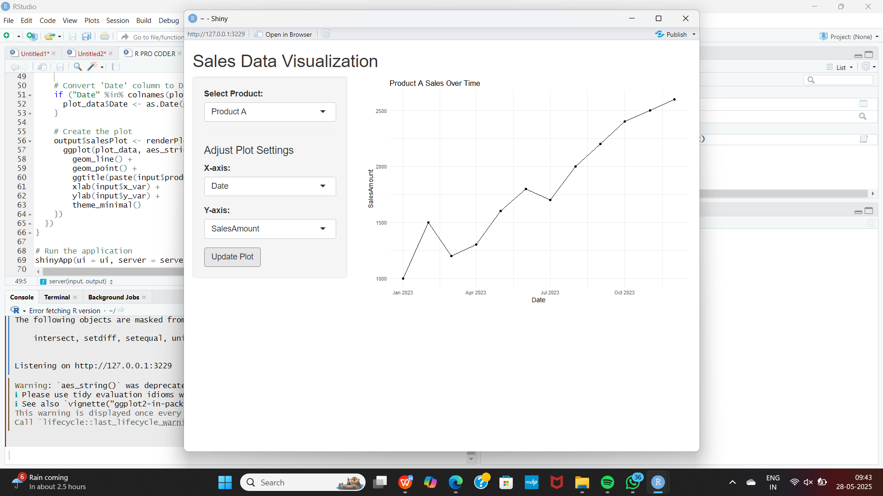
IMPLEMENTATION
The sales visualization tool displays product-wise sales trends using an interactive dashboard. Users can select products, adjust axes, and view updated line charts for better sales insights.

Slide 11
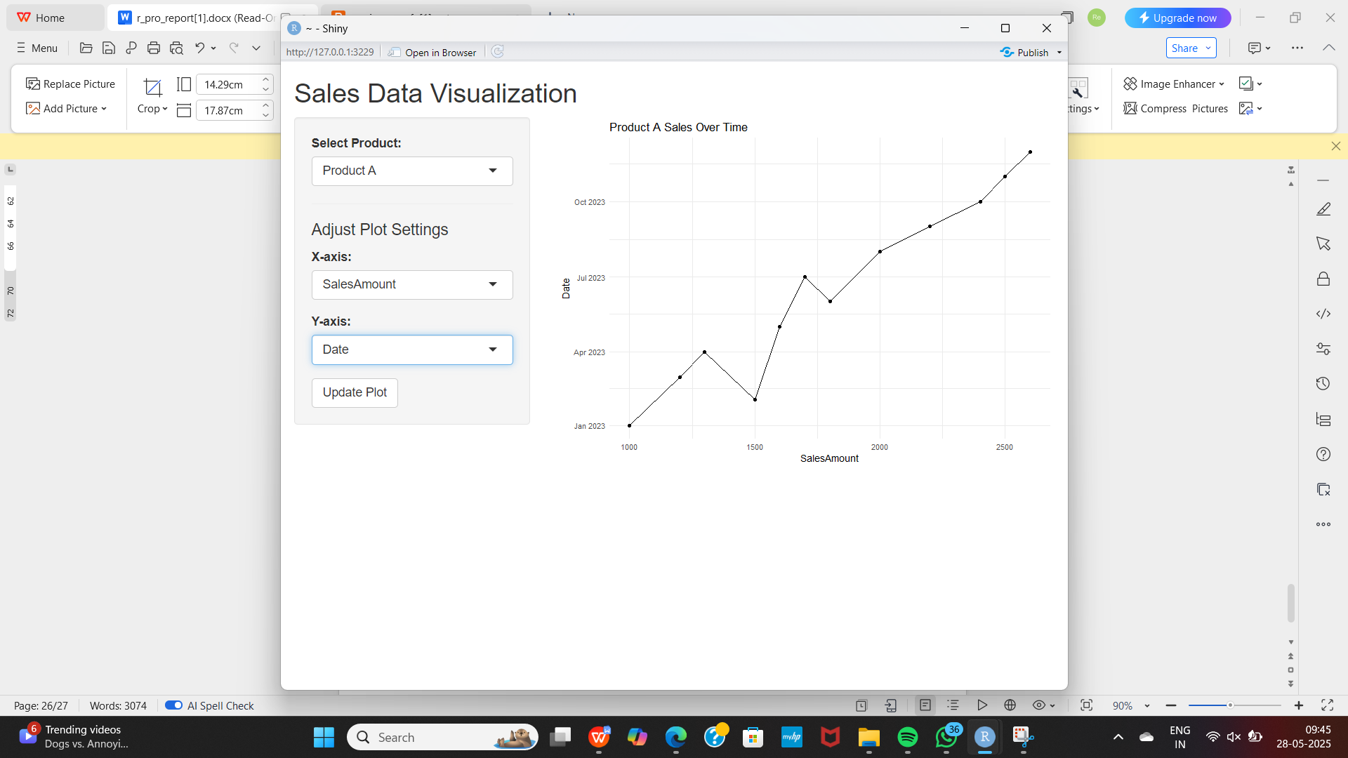
IMPLEMENTATION
This dashboard is implemented using R Shiny, enabling interactive sales data visualization. Users can select a product and adjust the plot axes (e.g., SalesAmount vs. Date). Upon clicking "Update Plot," the chart refreshes.

Slide 12
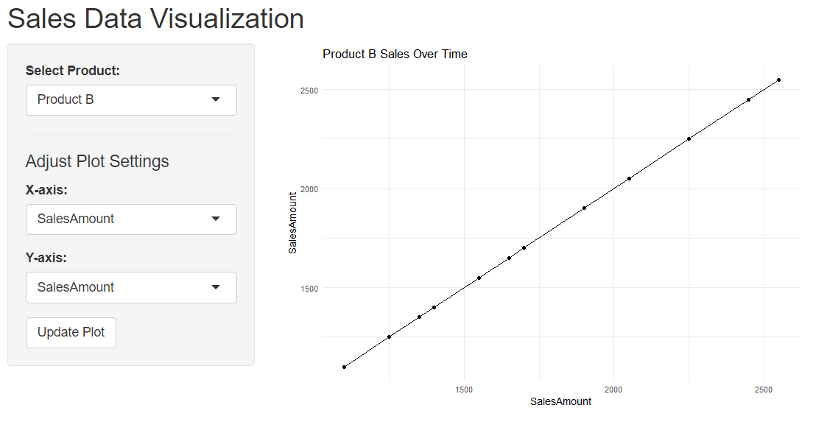
IMPLEMENTATION
Users select a product and customize axes to view sales data. The plot updates interactively based on selected settings.

Slide 13
CONCLUSION
The sales summary system successfully transforms raw sales data into actionable insights through data cleaning, summarization, forecasting, and automated reporting.
It streamlines business analysis, supports better decision-making, and lays the groundwork for more advanced analytics and future improvements.

Slide 14
Thank You
Any queries???

